Slide 1
SOUTH AFRICA: ECONOMIC OUTLOOK
Chamber of Commerce – Lugano, 22 September 2016
Suhail El Obeid, Senior Consultant, Switzerland Global Enterprise

Slide 2
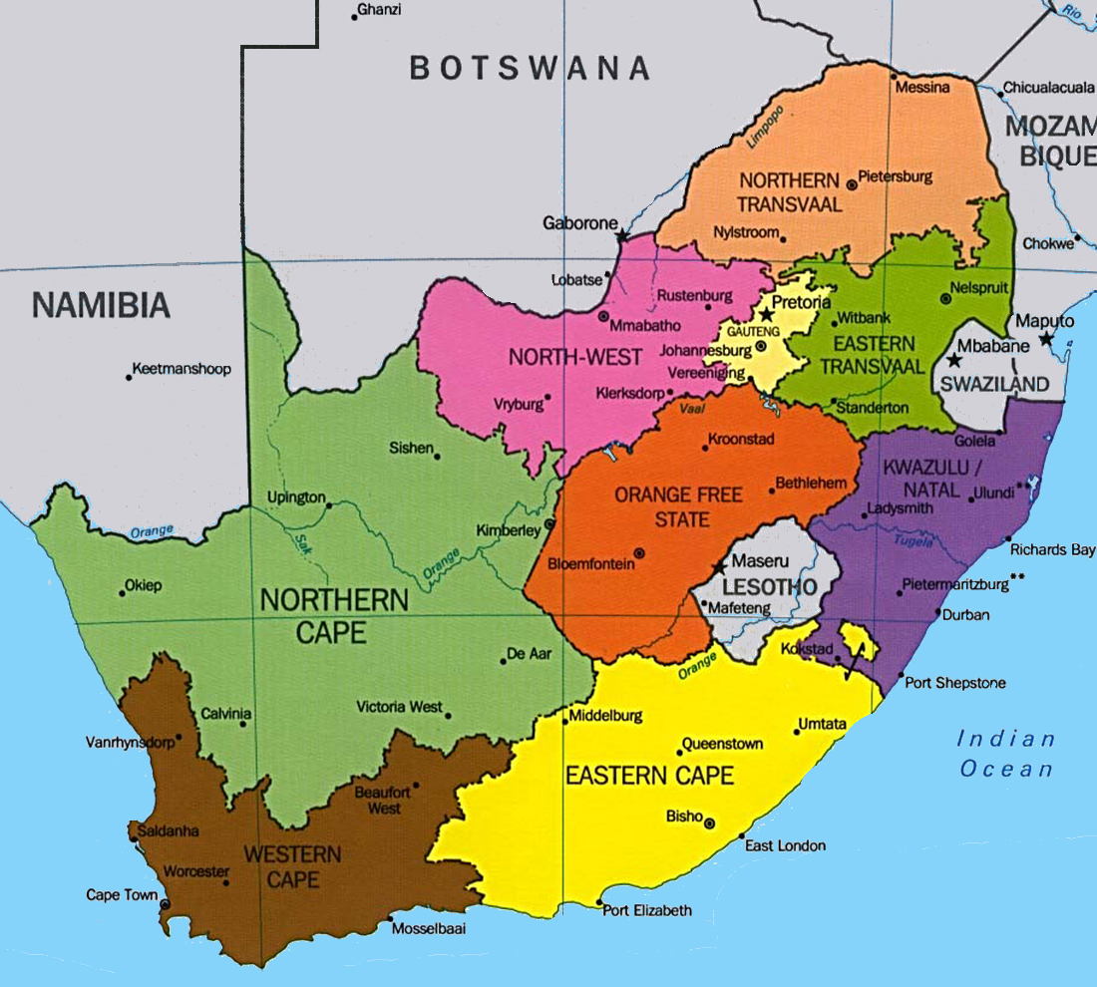
General Information Statistics
President Jacob ZUMA (ANC since 5/2009)
Size 1'219’090 km²
(CH 41'290 km² = 30x)
Capital Pretoria
Population 55 mil. (2015)
Growth Rate 1.6% (2014)
Provinces 9
Languages 11 official
Switzerland
Source: State Secretariat for Economic Affairs SECO/Country Information 2016

Slide 3
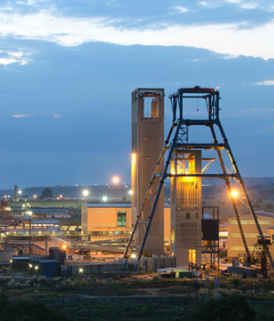
Economic Indicators Overview 2015
Real GDP $ 313bil.
Real GDP p.c. $ 5’694.60
Real GDP growth 1.6 %
Currency South African Rand
(ZAR)
Inflation 4.6%
Unemployment 25.4%
Sectors Services 67% (contribution GDP) Industry 30%
Mining 8%
Agriculture 2%
Source: State Secretariat for Economic Affairs SECO/Country Information 2016

Slide 4
Economic Indicators Foreign Trade of South Africa 2015
EXPORTS to
Total of USD 98,4 billion
IMPORTS from
Total of USD 89,3 billion
1 | EU | 27,4 billion | 29.1%
2 | China | 17,2 billion | 17.5%
3 | USA | 6,3 billion | 6.7%
20 | Switzerland | 2,182 billion | 2.4%
 | w/o precious metals | 0,233 billion | 0,25%
1 | EU | 17,8 billion | 20.0%
2 | China | 10,0 billion | 11.2%
3 | USA | 6,5 billion | 7.3%
12 | Switzerland | 0,675 billion | 0.6%
 | w/o precious metals | 0,674 billion | 0,6%
Source: State Secretariat for Economic Affairs SECO/Country Information 2016

Slide 5
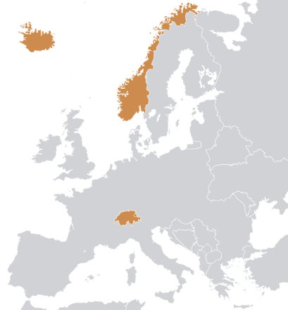
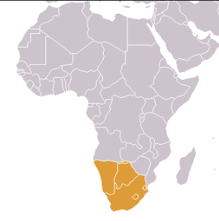
Economic Information South Africa – Free Trade Agreements
The Free Trade Agreement between the Member States of the European Free Trade Association (EFTA) - Iceland, Liechtenstein, Norway and Switzerland – and the Southern African Customs Union (SACU – comprising Botswana, Lesotho, Namibia, South Africa and Swaziland) entered into force on 1 May 2008.
South Africa | © SWITZERLAND GLOBAL ENTERPRISE

Slide 6
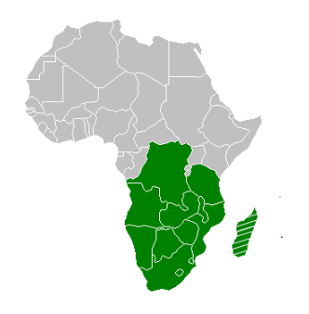
Economic Information South Africa – Free Trade Agreements
Easy access to the 15 countries in the Southern African Development Community (SADC) – with a combined market of over 250-million people.
South Africa | © SWITZERLAND GLOBAL ENTERPRISE

Slide 7
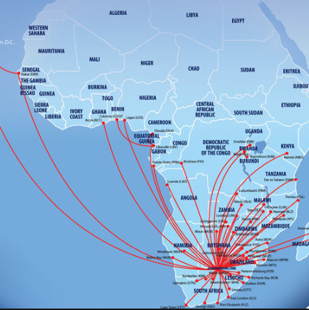
Economic Information South Africa – Gateway to the wider region
Due to its extensive transportation infrastructure and a highly regulated financial sector South Africa is considered the gateway to the rest of the 53 countries on the African continent.
South Africa | © SWITZERLAND GLOBAL ENTERPRISE

Slide 8
Economic Information South Africa – Economic overview
South Africa has the continent’s largest economy
South Africa is the continent's largest gold producer and ranks fifth in the world in diamond production and together with Platinum and Coal makes it among the riches countries globally in natural resources
Switzerland is the 10th largest investor in South Africa
100 Swiss companies are operational in South Africa creating 50’000 jobs
South Africa | © SWITZERLAND GLOBAL ENTERPRISE

Slide 9
SOUTH AFRICA: BUSINESS OPPORTUNITIES
Chamber of Commerce – Lugano, 22 September 2016
Alexandra Langeveldt-Theiler, Local Trade Advisor, Swiss Business Hub South Africa

Slide 10
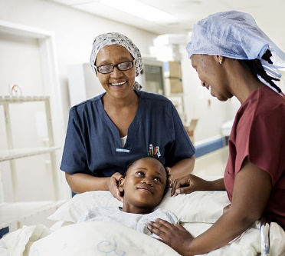
Promising Economic Environment Relevant Industries for Switzerland in South Africa
Information & Communication
Technology (ICT)
Development
Outsourcing
Cleantech
Consultancy services
Water saving technologies
Waste management
Healthcare
Medical devices and equipment
New build and refurbishment projects
Luxury Goods
Fashion
Accessories
Watches

Slide 11
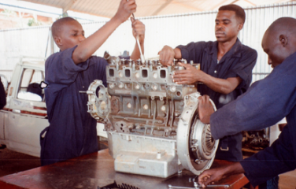
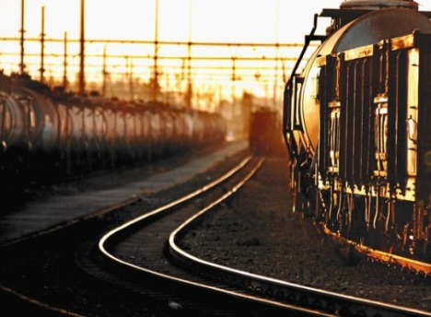
Promising Economic Environment Relevant Industries for Switzerland in South Africa
Food & Beverage
Health foods
Confectionery
Convenience foods
Education
Poor schooling system
Vocational training
Online universities
Rail
Heavy investments in freight and passenger rail: 31 billion CHF
Broad-Based Black Economic Empowerment (B-BBEE) legislation

Slide 12
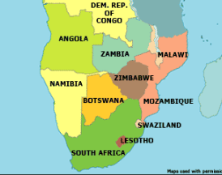
Other countries in the region
South Africa also serves as a gateway for the other countries in the region:
Angola, Botswana, Lesotho, Mauritius, Mozambique, Namibia, Swaziland
Source: Kwintessential (2015)

Slide 13
Other countries in the region Angola
The fastest growing sectors (until recently)
Oil and gas
Construction and infrastructure
Agriculture
Challenges of doing business in Angola
Poor power supply nationwide
Weak infrastructures across most sectors
Government bureaucracy
Corruption
High unemployment
Lack of skills
Opportunities in Angola
Infrastructure
Agriculture
Education and training
Power
Source: Kwintessential (2015)

Slide 14
Other countries in the region Botswana
Strengths
Relatively strong balance sheet
Prudent economic management
Long record of political stability
Sound policy framework
Low levels of government debt
No forex control
Individualised tax exemptions possible
Challenges of doing business in Botswana
Adjusting to lower diamond prices and other external shocks
A relatively slow pace of economic diversification
Opportunities in Botswana
ICT infrastructure
Mobile Service Solutions i.e. internet services provision
Source: Kwintessential (2015)

Slide 15
Other countries in the region Mauritius
Strengths
Political stability
Strategic location in the Indian Ocean
Secure investment location
Availability of legal, accounting and finance professionals
Availability of international arbitration
Challenges of doing business in Mauritius
Poor air connectivity to the African continent
Need for infrastructure improvement
Shortage of skilled workforce in certain sectors, such as engineering and IT
Opportunities in Mauritius
Education and training
Financial services
Power / renewable energy
Infrastructure
Source: Kwintessential (2015)

Slide 16
Other countries in the region Mozambique
Challenges doing business in Mozambique
Bureaucracy, pervasive influence of the political elites and widespread corruption
Poor infrastructure, resulting in higher logistical costs
Skills and education shortage coupled with tightening work permit regime
Portuguese as the official language
Opportunities in Mozambique
Oil and gas
Mining and infrastructure
Education and training
Source: Kwintessential (2015)

Slide 17
Doing Business in Southern Africa Take Time and be Aware
English is the official language when it comes to doing business (and Portuguese in Angola and Mozambique)
Business culture
Modes of communications
Making use of local experts
Source: Kwintessential (2015)

Slide 18
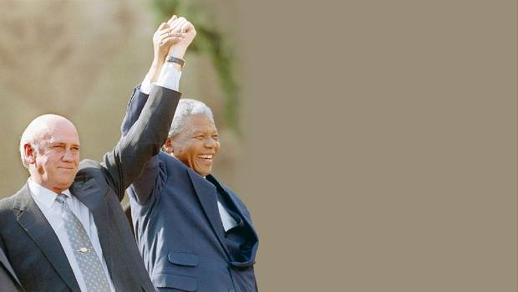
African Proverb
«If you want to go fast, go alone. If you want to go far, go together.»
Nelson Mandela and Frederic Willem de Klerk received the Nobel Peace Price In 1992

Slide 19
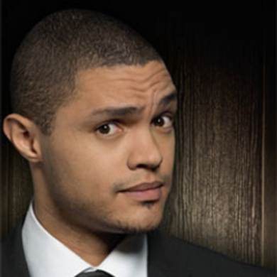
Most famous Swiss/South African
Roger Federer, Tennis Player
Trevor Noah, Comedian, television and radio host and actor

Slide 20
Thank you!

Slide 21
Our contact coordinates
Switzerland Global Enterprise
Stampfenbachstrasse 85 Corso Elvezia 16
CH-8006 Zurich CH-6900 Lugano
Contact person: Mr. Suhail El Obeid Contact person: Ms. Monica Zurfluh
Phone: +41 44 365 54 72 Phone: +41 91 601 86 86
selobeid@s-ge.com mzurfluh@s-ge.com
Swiss Business Hub South Africa
c/o Embassy of Switzerland to South Africa,
Botswana, Lesotho, Mauritius, Namibia and Swaziland
225 Veale Street, New Muckleneuk 0181
P.O. Box 2508, Brooklyn Square 0075, South Africa
Contact person: Ms. Alexandra Langeveldt-Theiler
Phone: +27 12 452 0690
alexandra.langeveldt-theiler@eda.admin.ch

