Slide 1
Credit Risk Management Mark Schulz Lugano, 22 September 2016

Slide 2
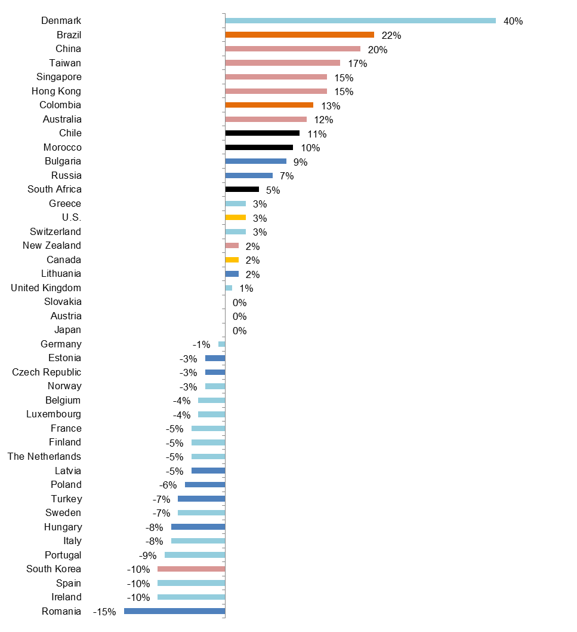
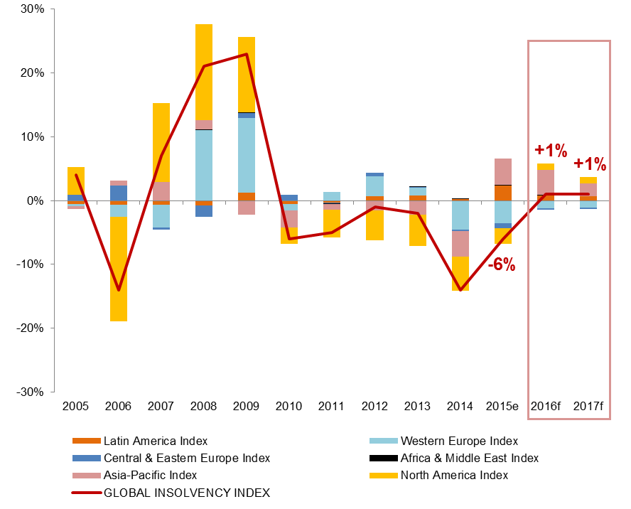
Increasing importance of credit risk management
Insolvencies to rebound in the U.S., continue to increase rapidly in Asia and Latin America and decrease in Europe
Insolvencies to increase worldwide for the first time since 2009
Global Insolvency Index (% change)
2016 insolvencies forecast (% change vs. 2015)
*
* New company form + statistical adjustment from tax authorities
Sources: National Statistics, Euler Hermes
Sources: National Statistics, Euler Hermes

Slide 3
Sensitive sectors in South Africa

Slide 4
Credit risk management basics
Information sources: Credit bureaus
Statutory information
Buyer identification: Company identification number
Financial information: No obligation to file financial statement
Sensitive information, available against NDA
Bank code: Additional information on financial flexibility
Legal forms: Public limited companies
Proprietary limited
Close corporations
State owned entities
Debt collection: Pre-legal
Legal

Slide 5
Thank you for your attention!
This material is published by Euler Hermes SA, a Company of Allianz, for information purposes only and should not be regarded as providing any specific advice. This publication and its contains are proprietary to Euler Hermes SA. Euler Hermes and Euler Hermes’ logo are trademarks or registered trademarks belonging to Euler Hermes Group, Worldwide Recipients should make their own independent evaluation of this information and no action should be taken, solely relying on it. This material should not be reproduced or disclosed without our consent. It is not intended for distribution in any jurisdiction in which this would be prohibited. Whilst this information is believed to be reliable, it has not been independently verified by Euler Hermes and Euler Hermes makes no representation or warranty (express or implied) of any kind, as regards the accuracy or completeness of this information, nor does it accept any responsibility or liability for any loss or damage arising in any way from any use made of or reliance placed on, this information. Unless otherwise stated, any views, forecasts, or estimates are solely those of the Euler Hermes Economics Department, as of this date and are subject to change without notice. The classification of this document is PUBLIC. Euler Hermes SA. Registered in Nanterre (552 040 594).Euler Hermes SA is authorized and regulated by the Financial Markets Authority of France.
© Copyright 2016 Euler Hermes. All rights reserved

